Slide 1
Coalition Formation in a Legislative Voting Game
Sotiris Georganas – U of London/Royal Holloway
(with Nels Christiansen – Trinity University
and
John Kagel – The Ohio State U)

Slide 2
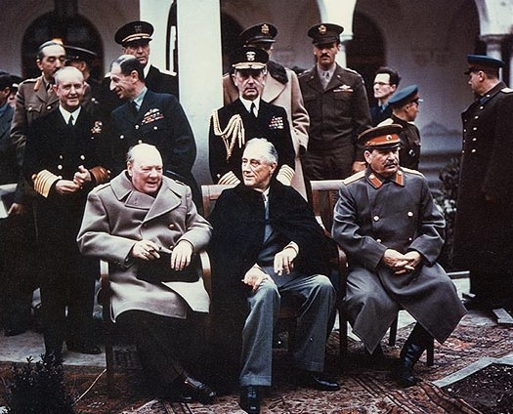
“politics makes strange bedfellows”
Notes:
Yalta summit, 1945, carving up spheres of influence in Europe

Slide 3
Motivation
In parlamentarian systems, legislators bargain in order to pass laws
Typically deal with:
  policy proposals (where to locate a train station, should gay/lesbian couples have the same partner rights as heterosexuals)
  purely distributive (private good) allocations
Important: Legislator preferences can be heterogeneous
Heterogeneity can lead to weird coalitions
  Leader of Free World Roosevelt gives (totalitarian) Stalin things he does not care much about (cash, food, arms, Poland) in order to get his support in the Greater Goal ; defeating the (totalitarian) Nazis
  Democrat Senators vote for the Invasion of Iraq in order to get cash for their state

Slide 4
Model (Jackson & Moselle 2002)
N legislators (n≥3 and odd)
Unidimensional public good
  Possibly a familiar ideological dimension (left-right)
  Single peaked preferences
  Heterogeneous costs of distance from peak
Private good (“pork”)
Dynamic game with discounting δ
Random legislator chosen to propose allocation of public/private good
  y, x₁, x₂, …,x_{n}
Majority voting
If majority, allocations realized. If no majority, then back to stage 1 with new proposal

Slide 5
Pork
Pork barrel
  pre-Civil War, slaves given barrel of salt pork as reward but then had to compete to get their share
  In 1863 E.E. Hale used pork as a metaphor for any form of public spending to the citizenry
Modern times?
Common Agricultural Policy in the EU
  About 44 billion euros, almost 31% of Union budget - used to be up to 50%!
  “Butter mountains and wine lakes”
In US
  Federal Highway Trust Fund
    To construct highways
    About $30 billion
  Army Corps of Engineers

Slide 6
Model predictions
“greasing the wheels”
  Pork as an instrument for legislative compromise
Not all bad
  Welfare can increase
    as measured by total value of legislator payoffs even after accounting for cost of private good
    idea here: legislator payoffs proxy for constituent’s interests

Slide 7
Why Lab Experiment?
In order to control preferences
Observe the bargaining process!
  Not enough inside information of what happens behind closed doors in Capitol Hill
External validity?
  No evidence that US senators or senior Eurocrats are more sophisticated (or better game theorists) than undergraduate students
  Just look at eurozone mess
    Or US debt ceiling mess

Slide 8
Literature
Growing literature on legislative Bargaining in games with fixed extensive form a la Baron-Ferejohn (1989)
Private Goods only
  McKelvey (1991)
  Diermeier and Morton (2005)
  Frechette, Kagel and Morelli (2005a)
  Frechette, Kagel and Morelli (2005b)
Private & Public (homogeneous preferences over public)
  Frechette, Kagel and Morelli (in press)
Christiansen (2010)
  public and private with different blocks of legislators having heterogeneous preferences over the funding level for public good
    Private good comes out of common pool for public good
    Not as versatile as Jackson-Moselle, cannot be used for understanding how pork affects bargaining rights
Notes:
skip

Slide 9
Our Experimental Design
N=3
Public good in [0,100]
  Costs of deviation (1, 3, 6)
  Players located at (0, 33, 100)
Total cash X=100
δ=1
  Default needed
  JM show it does not matter
All players submit proposals, one chosen at random
Almost neutral framing
  bargaining over location of bus stop
  UWC “unit walking costs”
Π=600 + UWC* (y_{i}*-y)+x_{i}
Key programming issue: make opportunity cost clear
  Calculate button, graphic showing the location and the exact distance to walk along with walking cost

Slide 10
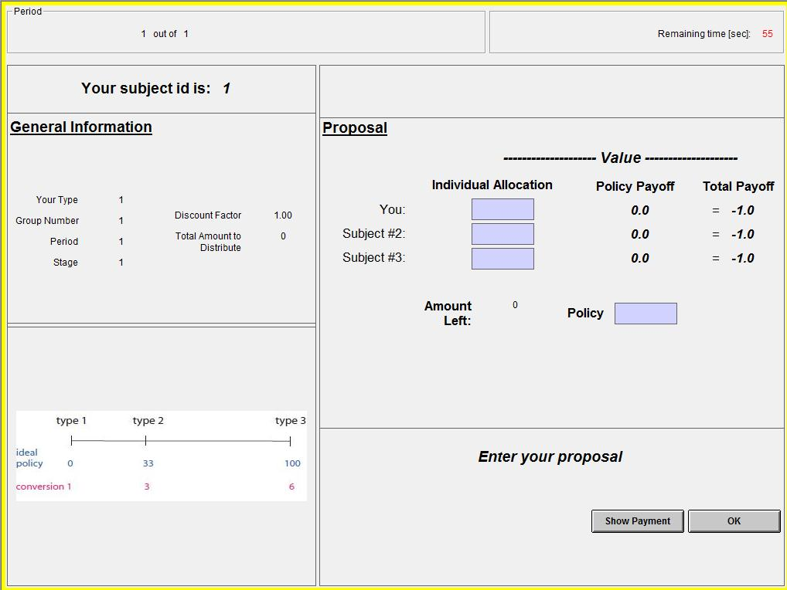
Notes:
fast

Slide 11
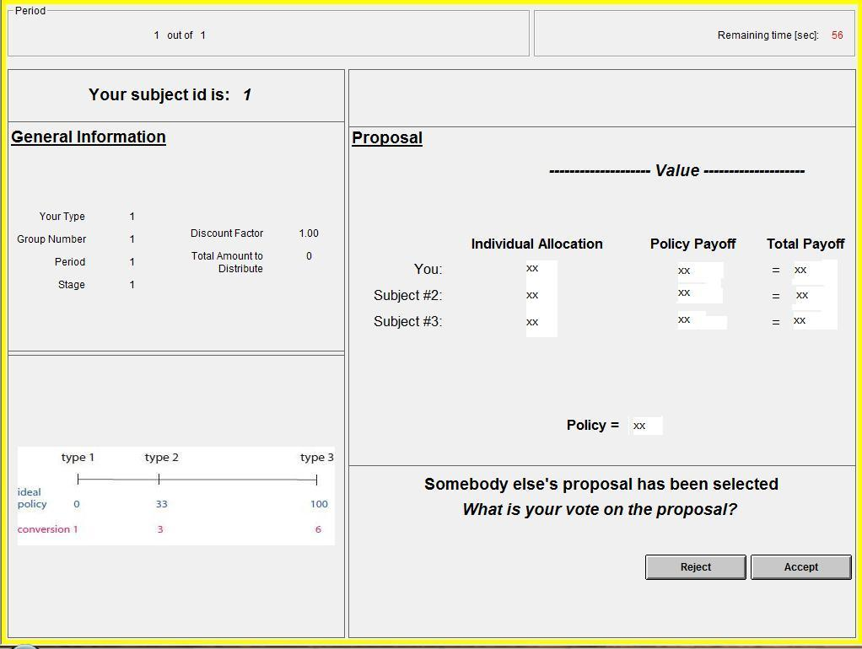

Slide 12
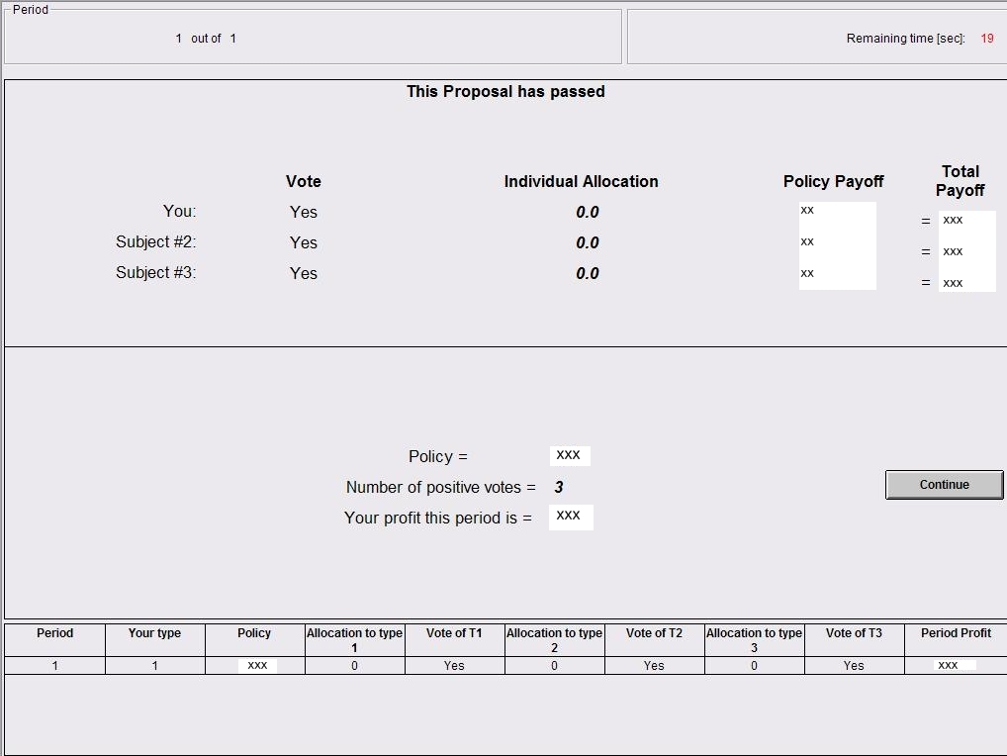

Slide 13
Predictions
Focus on stationary subgame perfect Nash equilibria (SSPE)
  Nash equilibria too many and with possibly very complex contingent strategies
If X=0 then median voter wins
If X>0 then proposer power
  T1 proposes (y, x₁, x₂, x₃) = (16.67, X, 0, 0 )
  T2 proposes (y, x₁, x₂, x₃) = (49.67, 0, X, 0 )
  T3 proposes (y, x₁, x₂, x₃) = (83, X, 0, 0 )
    Strange bedfellows!

Slide 14
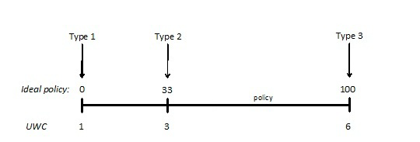
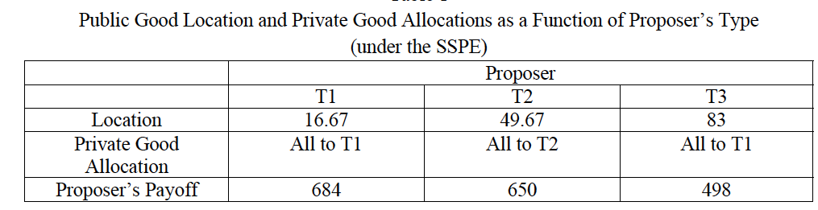

Slide 15
Sessions
Three sessions of public good only (42 subjects)
Three of public & private (39 subjects)
Focus on periods 7-15 after learning stabilizes
  Similar results including all periods – more noise
$6 show up fee
1 ECU = 3 cents
Mean earnings $20-22

Slide 16
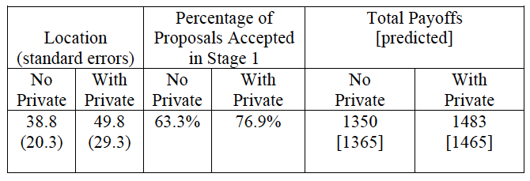
Results: Aggregate Outcomes
No private good (cash): close to median location, although there is some variance (Nash predicts 0)
Significant shift in location with private good (Mann-Whitney p<0.01 using rounds or 0.05 using sessions)
With private good: median location close to theory (49.8 versus 49.78)
  so is variance (858.5 versus 740.7)

Slide 17
Results: Aggregate Outcomes
Payoffs slightly lower than theory w/out cash, higher with
  cash increases payoffs (by 133) in line with theory (100)
    Note: not necessarily true with all parametrizations
Stage 1 proposals often rejected
  Similar to older results
  No cash: T1 and T3 make extreme proposals that get rejected
  With cash: All types make too self centered proposals
Introducing cash lowers stage 1 rejections
  The wheels are properly greased
Notes:
We don’t claim welfare always rises, just there are cases where it does

Slide 18
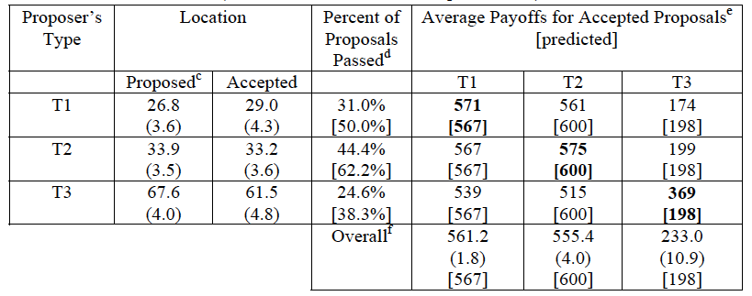
Results: by type – no cash
Accepted proposals included regardless of round
c: proposed for stage 1 only
d: top number % of accepted proposals, bottom accepted conditional on being chosen for voting

Slide 19
Results: by type – no cash
1) Proposals can be off. Accepted ones tend to go towards the equilibrium (33) (previous evidence?)
Accepted proposals included regardless of round
c: proposed for stage 1 only
d: top number % of accepted proposals, bottom accepted conditional on being chosen for voting

Slide 20
Results: by type – no cash
2) T2’s proposals have highest chance of acceptance
Accepted proposals included regardless of round
c: proposed for stage 1 only
d: top number % of accepted proposals, bottom accepted conditional on being chosen for voting

Slide 21
Results: by type – no cash
3) Proposers make more money, against theory.
T3’s payoff diff. highest, offset by low pass prob.
Accepted proposals included regardless of round
c: proposed for stage 1 only
d: top number % of accepted proposals, bottom accepted conditional on being chosen for voting

Slide 22
Results: by type – no cash
4) T1 and T2 overall payoffs surprisingly close to eachother, T3 low as predicted
Accepted proposals included regardless of round
c: proposed for stage 1 only
d: top number % of accepted proposals, bottom accepted conditional on being chosen for voting

Slide 23
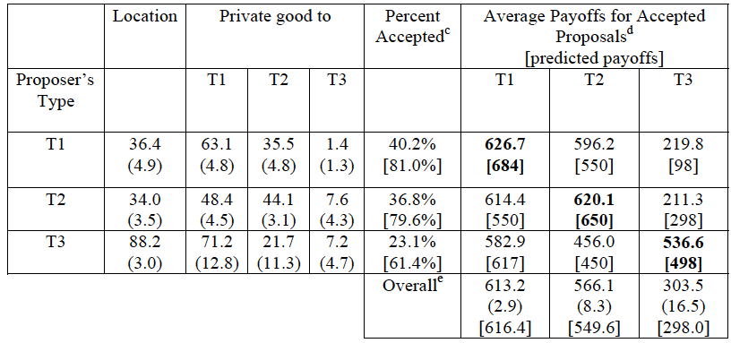
Results: by type – with cash
1) Accepted locations go up for all. (pred.=16.67, 49.67, 83). T3’s proposal close to predicted. T1 moves in wrong direction!
Accepted proposals included regardless of round
c: proposed for stage 1 only
d: top number % of accepted proposals, bottom accepted conditional on being chosen for voting
Notes:
Remember proposals are t1, t2, t3 16.67, 49.67, 83
Table only has accepted proposals

Slide 24
Results: by type – with cash
2a) T3 mostly gives cash to T1 (8 of 13 gave all). T1 keeps most, in line with theory.
Accepted proposals included regardless of round
c: proposed for stage 1 only
d: top number % of accepted proposals, bottom accepted conditional on being chosen for voting
Notes:
Maybe they don’t realize two people are enough? Equity concerns?

Slide 25
Results: by type – with cash
2b) T2 tends to split with T1 instead of attracting T3 with a high location
Accepted proposals included regardless of round
c: proposed for stage 1 only
d: top number % of accepted proposals, bottom accepted conditional on being chosen for voting
Notes:
The SSPE prediction that T2s will form coalitions with T3s is reasonably subtle as it essentially rests on the fact that T1s can demand relatively large payoffs unless T2s form coalitions with T3s. However, this winds up not to be the case, as the near equal splits T2s offer T1s are readily accepted, with T2s earning approximately what they would have gotten under the SSPE, while also having the highest average frequency with which their proposals were accepted.

Slide 26
Results: by type – with cash
3) T3 most rejected, T1 and T2 about the same
Accepted proposals included regardless of round
c: proposed for stage 1 only
d: top number % of accepted proposals, bottom accepted conditional on being chosen for voting

Slide 27
Results: by type – with cash
4) T3 higher payoff than predicted (cond. on accept), T1 and T2 less (no full exploitation of advantage)
Accepted proposals included regardless of round
c: proposed for stage 1 only
d: top number % of accepted proposals, bottom accepted conditional on being chosen for voting

Slide 28
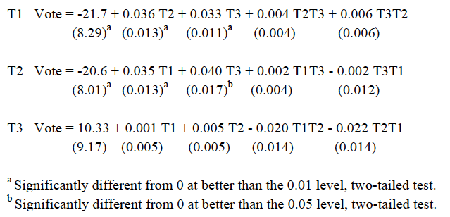
Results: voting probits
Notes:
random effect probits (with a subject random effect) for voting by the different player types with private goods available. The dependent variable is 1 for a yes vote; 0 otherwise

Slide 29
Is behavior individually rational?
Using voting probits and continuation values we can calculate what happens under alternative proposals
Expected payoff maximizing proposal - MAX
  Best response to actual behavior
Expected payoff from SSPE proposal
  Again given actual behavior
Efficient equal split - EES
  Payoff maximizing offer that equalizes payoffs of proposer and a coalition partner
Average expected return given actual offers
  Using actual probability of passing
Notes:
The expected payoff of an offer depends on the probability one or both of the other players accept the proposal, the proposer’s type, and the experimental continuation value for the game should the proposal be defeated. The latter is a type’s average payoff in the game weighted by the frequency of acceptance for each type of proposer. The experimental continuation values are 613, 566, and 304 for T1, T2, and T3, respectively.

Slide 30
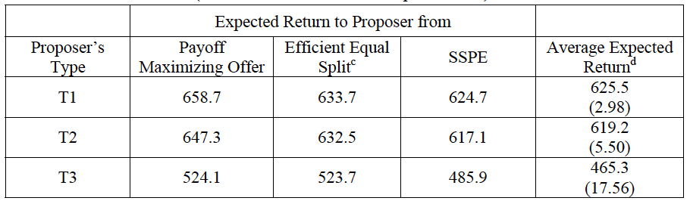
d: actual offers
Notes:
The payoff maximizing proposal that equalizes payoffs (within 1 ECU) between the proposer and one other coalition partner. The efficient splits are: T1 Proposer: Y=33, PT1=67, PT2=33, PT3=0 T2 Proposer: Y=33, PT1=66, PT2=34, PT3=0 T3 Proposer: Y=100, PT1=100, PT2=0, PT3=0, where PTi = private goods to type Ti (xi).

Slide 31
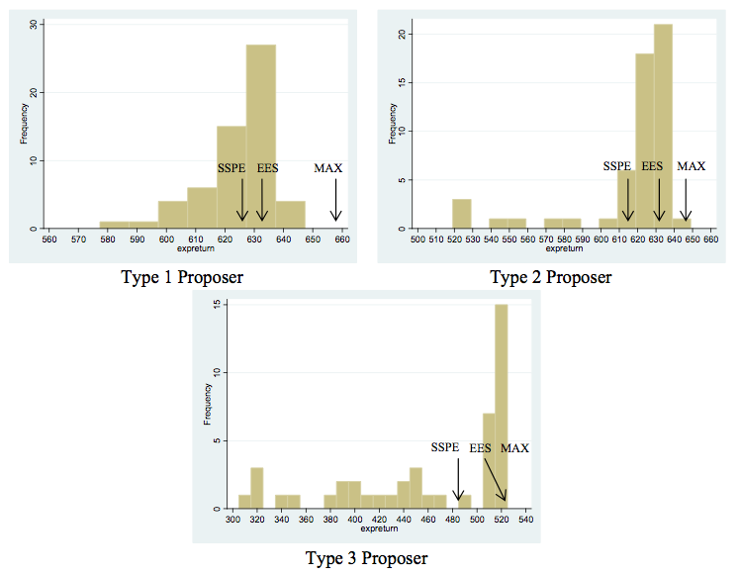

Slide 32
Anecdotal evidence from strange planefellows
Earmarks are “premium pork”
In early 00’s bill gets voted upon (in House and Senate) and then earmarks are added in conference (where they try to merge proposals)
  Earmarks anonymous, failed requests not made public
  If you vote for bill you get money (according to seniority, what Committee you’re in, coming tough elections)
Ca. 2007 names of member of Congress added to earmarks
  Transparency requirements for everyone (earmark requests had to be on website)
    Some Congressmen were actually proud of it, so filled their website with earmark requests
    Others more careful, just a few focused ones
Upon election Obama pledges to veto any bill with earmarks
Strange bedfellows: Labor – HHS - Education appropriations bill
  Total $700 billion – discretionary part $170 billion
  Traditionally Bipartisan support
    Democrats would almost unanimously vote for, although it had provisions against abortion
  Now, without earmarks, it does not even go through House floor
    So only funded through stopgap measures: Continuing Resolution (keeps spending at older levels, this year a bit lower because of deficit)

Slide 33
Comparing theory, lab and field
Stage 1 rejections
  Theory ✗ Lab ✓ Washington, DC ✓
Strange bedfellows
  Theory ✓ Lab ✓ Washington, DC ✓✓
Positive net welfare effect of pork
  Theory ✗ Lab ✓ Washington, DC ??

Slide 34
Conclusions
Legislative Bargaining over private and public good with heterogeneous preferences
Stage 1 rejections
Efficient equal split common
Pork
  greases the wheels
  raises acceptance rates
  and welfare
Allow pork?
  Allow earmarks?

Slide 35
Thank you!

Slide 36
Parallel Treatment
In the beginning (before improving the interface) 136 yielded noisy results
New treatment in order to check if incentives to play equilibrium were too low
X=200, UWC=3, 4 and 8
  more cash to grease the wheels
Downside: mixed strategy equilibria
4 sessions

Slide 37
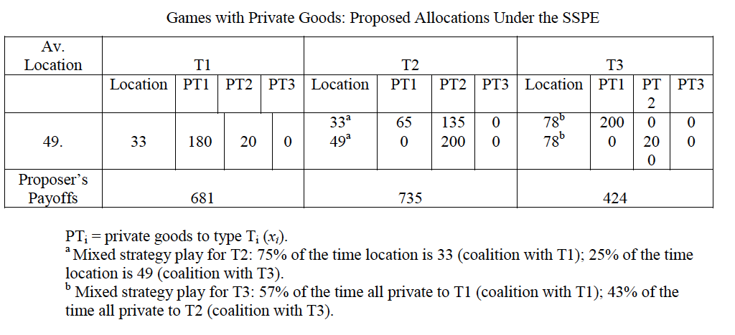

Slide 38
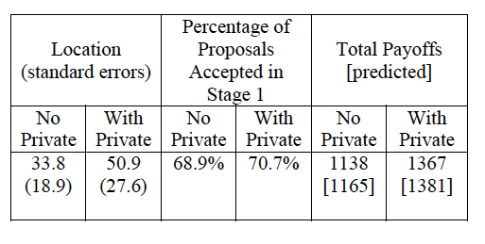
Aggregate outcomes

Slide 39
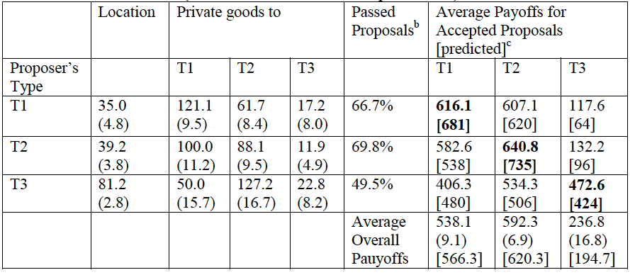

Slide 40
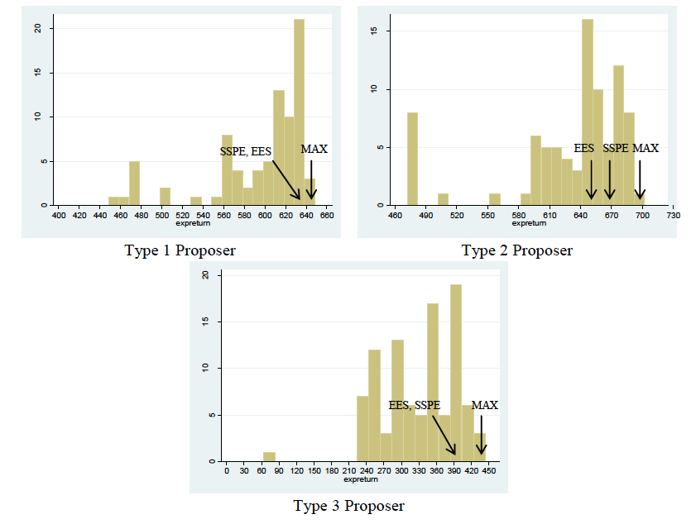

Slide 41
US evidence
In early 00’s bill gets voted upon (in House and Senate) and then earmarks are added in conference (where they try to merge proposals)
  Earmarks anonymous, failed requests not made public
  If you vote for bill you get money (according to seniority, what Committee you’re in, coming tough elections)
Ca 2007 names of member of Congress added to earmarks
  Transparency requirements for everyone (earmark requests had to be on website)
    Some Congressmen were actually proud of it, so filled their website with earmark requests
    Others more careful, just a few focused ones
Reform mid to late 00’s: earmarks have to be there in the underlying texts
  Pork gets allocated in similar way, but you don’t know if people will vote for it
  Could change just a bit in conference if legislator very annoying
Now: no earmarks (president pledged to veto any bills with earmarks)
  People hope they will come back to grease the wheels
  (see article in Politico)
  Would also get more contributions (as earmarks could go to particular lobby)
    Would allow Congressmen to focus more
  Presidents always prefer to ban earmarks and allocate the money themselves
    E.g. through Army Corps of Engineers
Strange bedfellows: Labor – HHS - Education appropriations bill
  Total $700 billion – discretionary part $170 billion
  Traditionally Bipartisan support
  Democrats would almost unanimously vote for, although it had provisions against abortion
  Now it does not even go through House floor
    So only funded through stopgap measures: Continuing Resolution (keeps spending at older levels, this year a bit lower because of deficit)
Fiscal 2006 big fight about LIHEAP and Chairman of Committee decided to take away all earmarks
  Bill went from Conference to House and failed
  Then armtwisting etc to get it to pass
Notes:
Thomas Congressional Research service, public information

